Slide 1
2018 HEALTH FAIR AND BACK 2 SCHOOL RALLY

Slide 2
Every child is a gift, they just unwrap their packages at different times and different addresses. Anonymous

Slide 3
NAACP GARLAND
garlandtxnaacp.org

Slide 4
SPONSORS & PARTNERS
BANK OF AMERICA
CITY OF GARLAND
DRUG PREVENTION RESOURCES / IMPACT
GARLAND ASSOCIATION FOR HISPANIC AFFAIRS (GAFHA)

Slide 5
SPONSORS & PARTNERS
GARLAND FAITH COMMUNITY SEVENTH-DAY ADVENTIST CHURCH
GARLAND INDEPENDENT SCHOOL DISTRICT
HALF PRICE BOOKS GARLAND
KROGER
MOUNT HEBRON BAPTIST CHURCH

Slide 6
SPONSORS & PARTNERS
NORTH EAST DALLAS JACK AND JILL
NOON EXCHANGE CLUB OF GARLAND
PARKLAND COMMUNITY SERVICES
WALMART

Slide 7
SPONSORS & PARTNERS
GARLAND AREA BROTHERHOOD
GARLAND CLUB NANBPWC INC.
UNITY IN COMMUNITY CHURCHES

Slide 8
SPONSORS & PARTNERS
GAABSE
COMMUNITY MULTICULTURAL COMMISSION

Slide 9
Mount Hebron Baptist Church 1233 State Highway 66 Garland, Texas 75040 972.276.5218
onthemount.org

Slide 10
Garland Faith Community Seventh-day Adventist Church 1702 E Centerville Rd Garland, TX 75041
gfccadventist.org

Slide 11
DRUG PREVENTION RESOURCES IMPACT GARLAND dpri.com

Slide 13
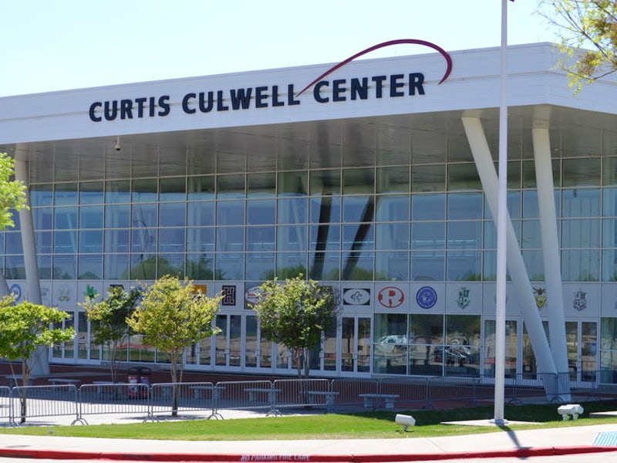

Slide 15
gafha.net

Slide 17
The Noon Exchange Club of Garland
noonexchangeclubofgarland.org

Slide 18
Randolph-Brooks Federal Credit Union rbfcu.org
Jesse Sanchez
jessesanchez@rbfcu.or
469.500.5363

Slide 19
Just because you may not have what others have
doesn’t mean you don’t have what it takes.
Anonymous

Slide 20
Free Workshops for GISD Families Talleres gratis para familias del GISD

Slide 21
Positive Parenting Program
October 25, 2018
November 15, 2018
February 7, 2019
April 25, 2019
All seminars will be held at the
Jill Shugart Professional Development Center
870 W. Buckingham Rd. Garland, TX 75041
6:00—7:30 p.m.
@gisdengagement
#gisdfamily
#gisdcommunity
www.triplep-parenting.net

Slide 22
El poder de padres positivos
25 de octubre, 2018
15 de noviembre, 2018
7 de febrero, 2018
25 de abril, 2019
Todos los seminaries se llevarán acabo en
Jill Shugart Professional Development Center
870 W. Buckingham Rd. Garland, TX 75041
6:00—7:30 p.m.
@gisdengagement
#gisdfamily
#gisdcommunity
www.triplep-parenting.net

Slide 23
Chương trình Phụ Huynh Lạc quan
Ngày 25 tháng 10, 2018
Ngày 15 tháng 11, 2018
Ngày 7 tháng 2, 2019
Ngày 25 tháng 4, 2019
Tất cả các cuộc hội thảo sẽ được tổ chức tại
Jill Shugart Professional Development Center
870 W. Buckingham Rd. Garland, TX 75041
6:00 - 7:30 chiều
@gisdengagement
#gisdfamily
#gisdcommunity
www.triplep-parenting.net

Slide 24
SCREENINGS AVAILABLE
ON THE CONCOURSE LEVEL
City of Garland – Immunizations
Walmart - Vision Screening
Habla Speech Therapy
- Speech and Language Screening

Slide 25
SCREENINGS AVAILABLE
ON THE ARENA FLOOR
Free Clothes - Garland Faith Community
SDA Church

Slide 26
FREE BOOKS
ARENA FLOOR
NED Jack and Jill of America

