Slide 1
August 11, 2018
NAACP Garland Unit
2018 Health Fair and Back 2 School Rally

Slide 3
2018 Health Fair and Back 2 School Rally

Slide 12
2018 Health Fair and Back 2 School Rally

Slide 18
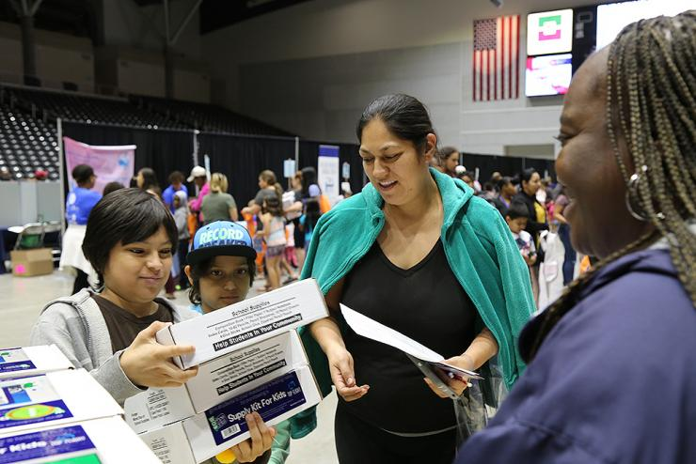

Slide 19
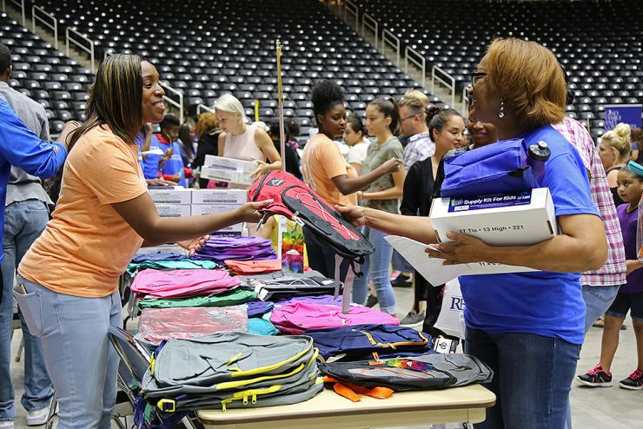

Slide 20
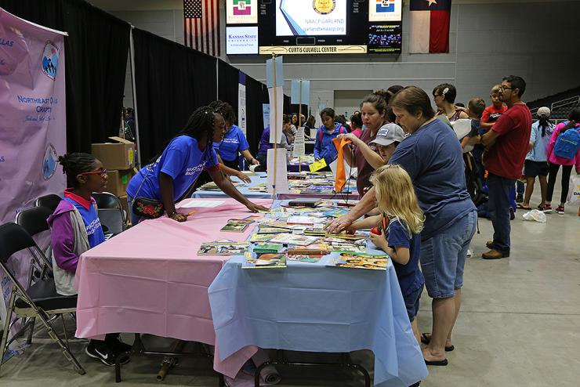

Slide 21
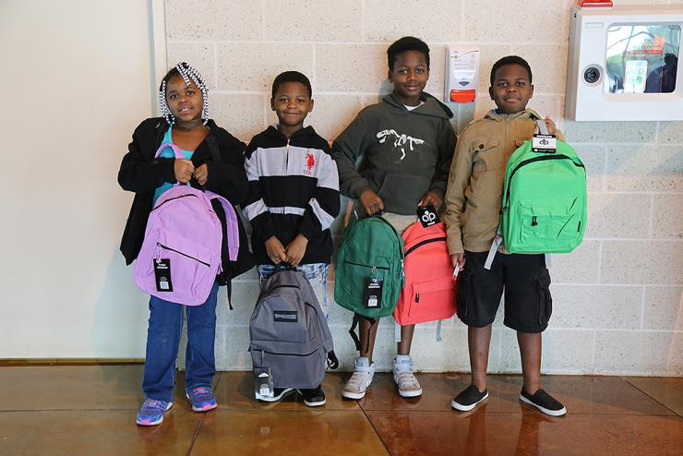

Slide 22
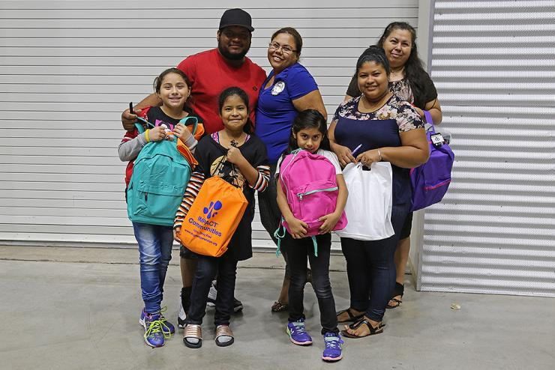

Slide 23
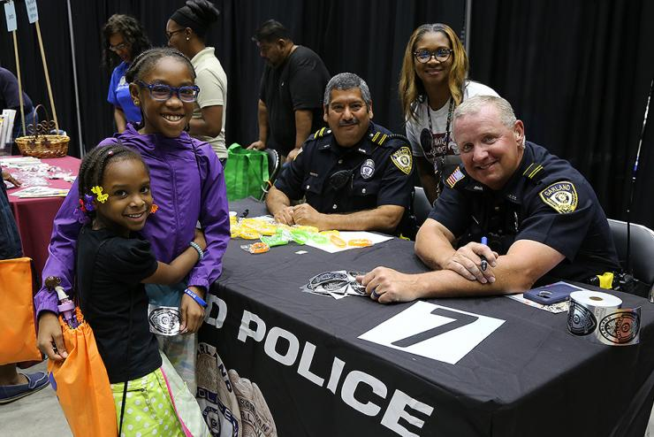

Slide 24
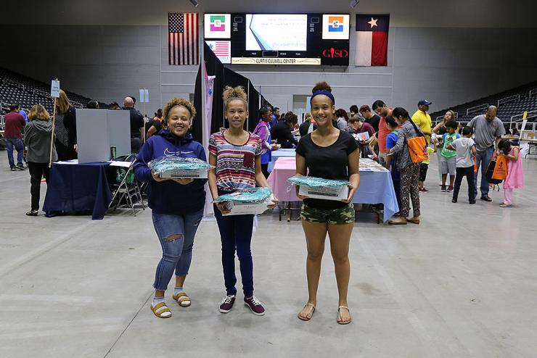

Slide 26
