Slide 1
OVERVIEW OF TEXAS VETERANS COMMISSION CLAIMS ASISSTANCE DEPARTMENT JAY GASMEN TVC DALLAS VA MEDICAL CENTER

Slide 2
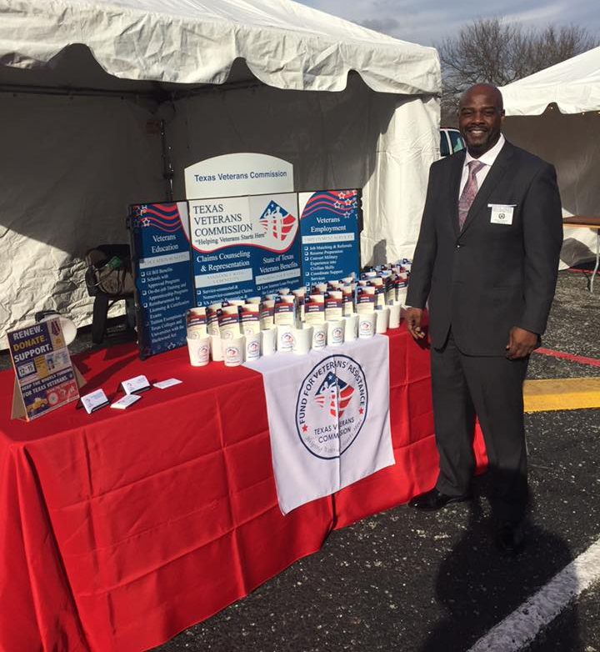
Claims Services
Start / File a Claim
Service-Connected Disability Compensation
Non-Service Connected Pension
Widow / Survivors Benefits
File Appeal
PARTNERS
Veterans Benefits Administration
Texas County Veteran’s Service Officers
TVC Healthcare Advocacy Department

Slide 3
IGMEDIO “JAY” GASMEN
TVC DALLAS VAMC OFFICE SUPERVISOR
Cell : (214) 399-5637
E-Mail: igmedio.gasmen@tvc.texas.gov
For Appointments:
CALL: 214-433-2122

