Slide 1
Mission * To advocate for and provide superior service to veterans that will significantly improve the quality of life for all Texas veterans, their families, and survivors.

Slide 2
The Women Veterans Program Mission
Ensure women veterans of Texas have equitable access to benefits and services

Slide 3
Women Veteran Coordinators
Dr. Krystle Matthews, Ed.D., HRD – Program Manager - East Texas
Cynthia Lendof – West Texas
Sharron Stewart – Central & South Texas
Catherine Smith – North Texas & the Panhandle
Dedicated to improving the lives of our Women Veterans and their families.

Slide 4
Program Duties
Provide assistance to Texas women veterans
Perform outreach to improve awareness of benefits
Assess women veterans needs
Review programs, research projects, and other initiatives that address women veterans needs
Make recommendations to agency Executive Director
Incorporate women Veterans’ issues in commission planning
Collaborate with state agencies to provide information
Honor and recognize our Women Veterans of Texas

Slide 5
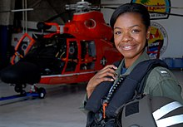
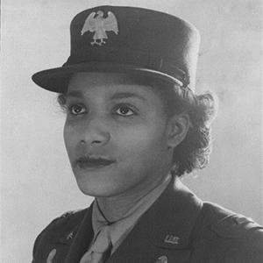
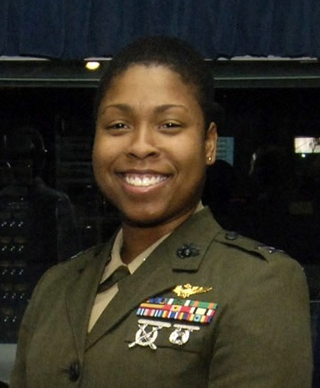
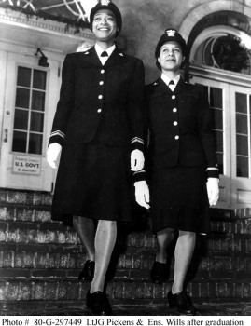
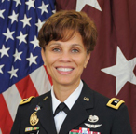
Trailblazers

Slide 6
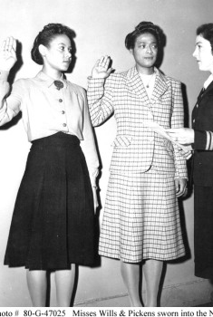
Lieutenant (Junior Grade) Harriet Ida Pickens and Ensign Frances Wills First Black Women commissioned as Naval Officers as members of the Navy’s Female Reserve Program (WAVES) (Women Accepted for Volunteer Emergency Service). https://usnhistory.navylive.dodlive.mil/2014/10/17/remembering-the-first-black-woman-naval-officers/

Slide 7
Major Charity Adams
Commander of the first and only all-female all black army unit (WAAC (Women’s Army Auxiliary Corps)). https://www.womenshistory.org/education-resources/biographies/charity-earley

Slide 8
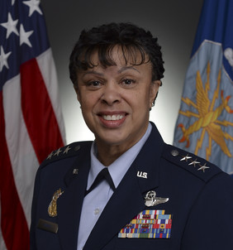
Lieutenant General
Stace D. Harris
First African American Female Air Force Lieutenant General
https://www.af.mil/About-Us/Biographies/Display/Article/931147/lieutenant-general-stayce-d-harris/

Slide 9
Vernice Armour (Dates of Service 1993-2007)
First African Female Naval Aviator in the Marine Corps and the First African American Female Combat Pilot in the U.S. Armed Forces.
https://en.wikipedia.org/wiki/Vernice_Armour

Slide 10
Lt. Commander La’Shanda R. Homes, U.S. Coast Guard
First African American female helicopter pilot for the Coast Guard.
https://en.wikipedia.org/wiki/La%27Shanda_Holmes

Slide 11
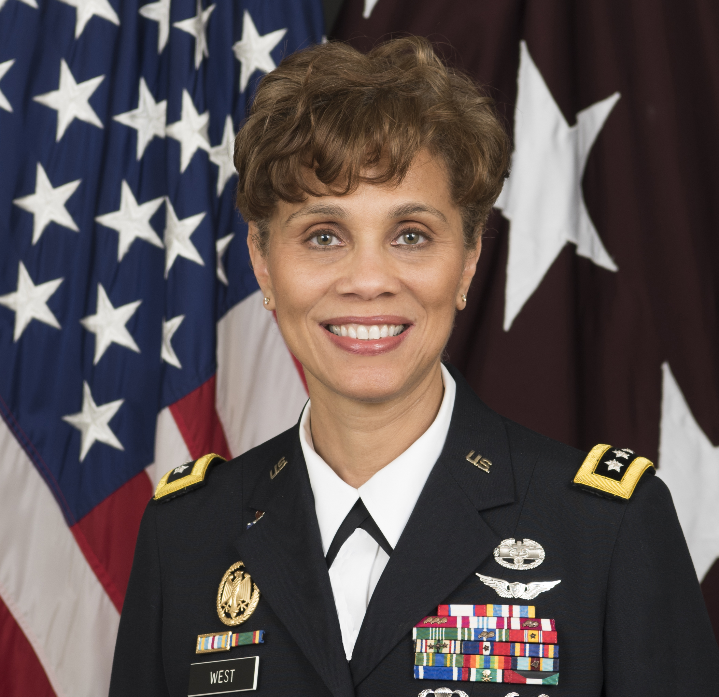
Brigadier General
Hazel Johnson-Brown
First black female active-duty Major General. 44th Army Surgeon General and former Commanding General of the US Army Medical Command. https://en.wikipedia.org/wiki/Nadja_West

Slide 12
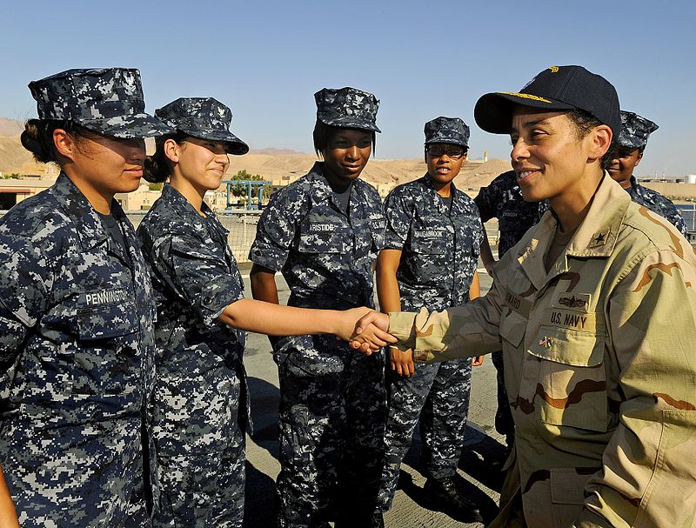
Michelle Janine Howard
First United States Navy Four-Star Admiral (First African American to Command a Naval Ship) (Dates of service 1982-2017)
https://en.wikipedia.org/wiki/Michelle_Howard

Slide 13
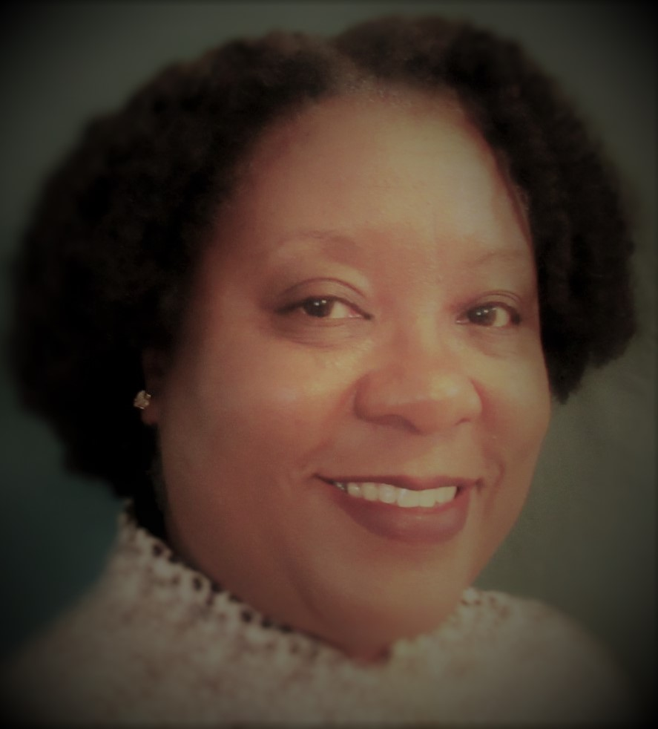
Catherine B. Smith U.S. Army Women Veterans Coordinator Texas Veterans Commission Catherine.smith@tvc.texas.gov 214-412-4666

Slide 14
Texas Veterans Commission Programs
Claims Veterans Employment Services
Education Entrepreneurs
Grants Health Care Advocacy
Mental Health Women Veterans Program

Slide 15
Texas Veterans Commission https://www.tvc.texas.gov/
1-800-252-VETS (8387) or (832) 728-3624
Facebook.com/texasveteranscommission
Twitter - @texasveterans
https://www.tvc.texas.gov/women-veterans/

